Slide 1
Functional Dependency

Slide 2
Overview
Domain; Ref. Integrity constraints
Assertions and Triggers
Security
Functional dependencies
  why
  definition
  Armstrong’s “axioms”
  closure and cover

Slide 3
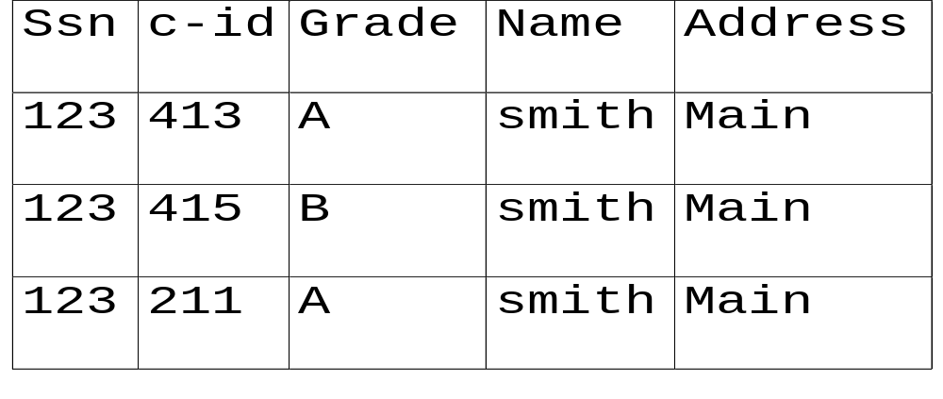
Functional dependencies
takes1 (ssn, c-id, grade, name, address)

Slide 4
Functional Dependencies
Redundancy
  space
  inconsistencies
  insertion/deletion anomalies
What caused the problem?

Slide 5

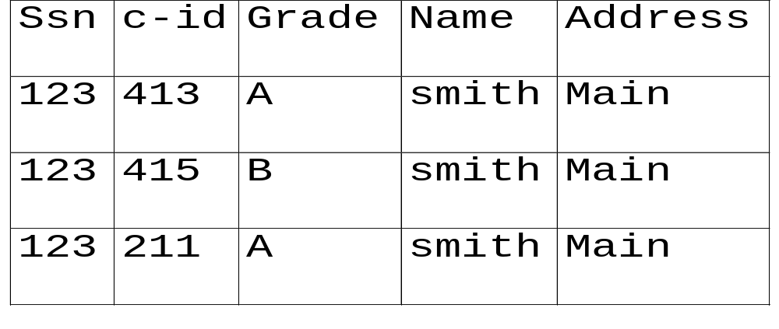
Functional dependencies
Definition:
‘a’ functionally determines ‘b’

Slide 6
Functional dependencies
formally:
if two tuples agree on the ‘X’ attribute,
they *must* agree on the ‘Y’ attribute, too
(e.g., if ssn is the same, so should address)
… a functional dependency is a generalization of the notion of a key

Slide 7
Functional dependencies
K is a superkey for relation R iff K -> R
K is a candidate key for relation R iff:
  K -> R
  for no a ⊂ K, a -> R

Slide 8
Functional dependencies
Closure of a set of FD: all implied FDs – e.g.:
  ssn -> name, address
  ssn, c-id -> grade
imply
  ssn, c-id -> grade, name, address
  ssn, c-id -> ssn

Slide 9
FDs - Armstrong’s axioms
Closure of a set of FD: all implied FDs – e.g.:
  ssn -> name, address
  ssn, c-id -> grade
how to find all the implied ones, systematically?

Slide 10


FDs - Armstrong’s axioms
“Armstrong’s axioms” guarantee soundness and completeness:
Reflexivity:
e.g., ssn, name -> ssn
Augmentation
e.g., ssn->name then ssn,grade-> ssn,grade

Slide 11
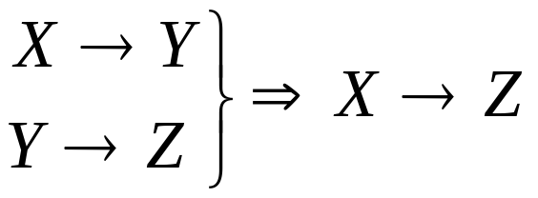
FDs - Armstrong’s axioms
Transitivity
  ssn->address
  address-> county-tax-rate
  THEN:
  ssn-> county-tax-rate

Slide 12
FDs - Armstrong’s axioms
Reflexivity:
Augmentation:
Transitivity:
‘sound’ and ‘complete’

Slide 13
Trivial FDs
The FD X→Y is trivial if set {Y} is a subset of set {X}
Examples: If A and B are attributes of R,
{A}→{A}
{A,B} →{A}
{A,B} →{B}
{A,B} →{A,B}
are all trivial FDs.

Slide 14
Full functional Dependency
A full functional dependency occurs when you already meet the requirements for a functional dependency and the set of attributes on the left side of the functional dependency statement cannot be reduced any farther.
For example, “{SSN, age} -> name” is a functional dependency, but it is not a full functional dependency because you can remove age from the left side of the statement without impacting the dependency relationship

Slide 15
Closure of a set of attributes
Closure of a set of attributes X with respect to is the set X⁺ of all attributes that are functionally determined by X using ⁺
Imagine the following list of FD's. We are going to calculate a closure for A from this relationship.
A → B B → C AB → D
The closure would be as follows:
  a) A → A ( by Armstrong's reflexivity )
  b) A → AB ( by 1. and (a ))
  c) A → ABD ( by (b), 3, and Armstrong's transitivity )
  d) A → ABCD ( by (c), and 2 )
The closure is therefore A → ABCD. By calculating the closure of A, we have validated that A is also a good candidate key as its closure is every single data value in the relationship.

Slide 16
FDs – finding the closure F+
F⁺ = F
repeat
for each functional dependency f in F⁺
apply reflexivity and augmentation rules on f
add the resulting functional dependencies to F⁺
for each pair of functional dependencies f₁and f₂ in F⁺
if f₁ and f₂ can be combined using transitivity
then add the resulting functional dependency to F⁺
until F⁺ does not change any further
We can further simplify manual computation of F⁺ by using the following additional rules →

Slide 17
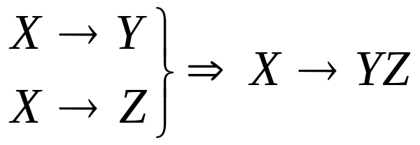
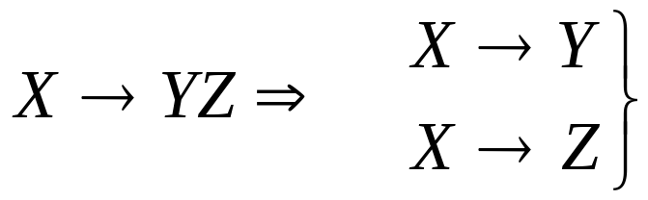
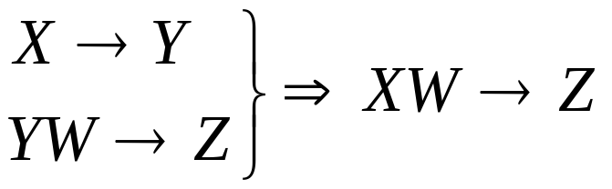
FDs - Armstrong’s axioms
Additional rules:
Union
Decomposition
Pseudo-transitivity

Slide 18
FDs - Closure A+
Algorithm to compute α⁺, the closure of α under F
result := α;
while (changes to result) do
for each β → γ in F do
begin
if β ⊆ result then result := result ∪ γ
end

Slide 19
FDs - Closure A+ (example)
R = (A, B, C, G, H, I)
F = {A → B, A → C, CG → H, CG → I, B → H}
(AG)⁺
  1. result = AG
  2. result = ABCG (A → C and A → B)
  3. result = ABCGH (CG → H and CG ⊆ AGBC)
  4. result = ABCGHI (CG → I and CG ⊆ AGBCH)
Is AG a candidate key?
  Is AG a super key?
    Does AG → R?
  Is any subset of AG a superkey?
    Does A⁺ → R?
    Does G⁺ → R?

